Slide 1
Talk 38 Vietnam War part three

Slide 2
TET 1968

Slide 3
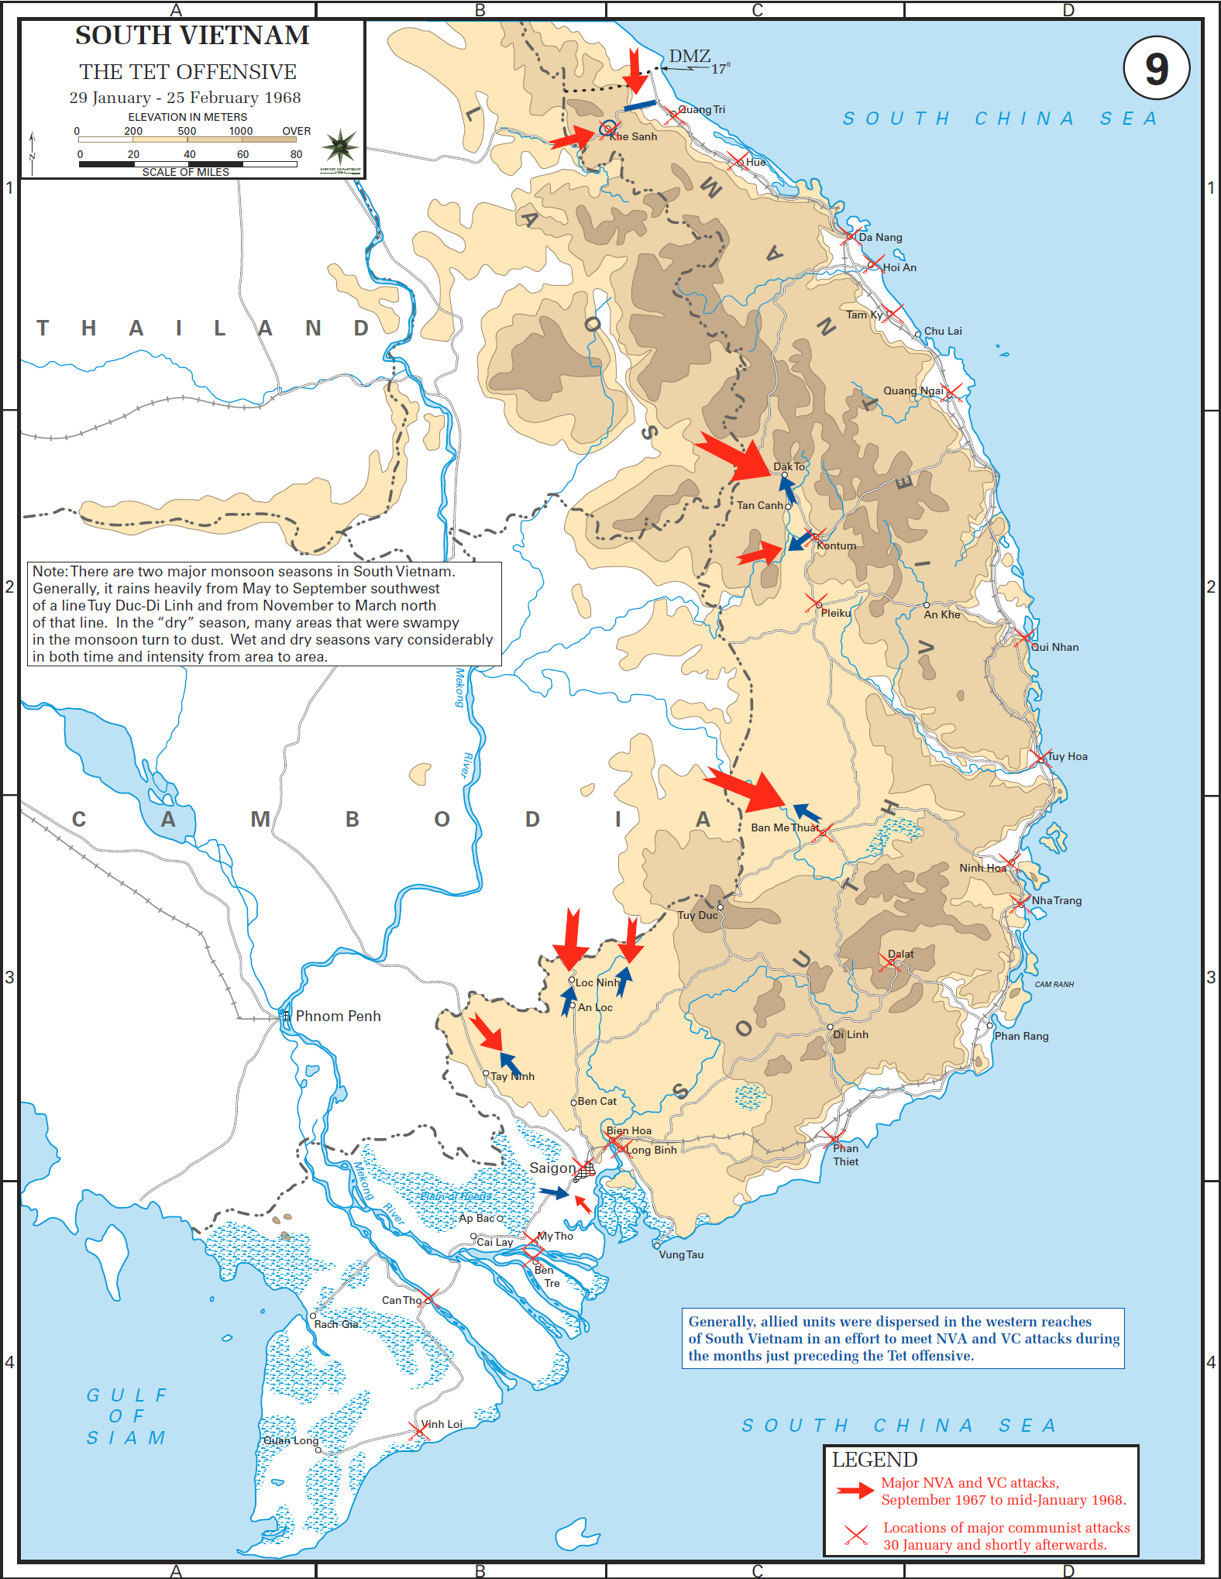
Tet Offensive: January/ February 1968
VC Attacks
Truce announced during TET holiday
N Vietnamese: 200,000 reinforcements …total army 400,000,
Attack US base Khe Sanh
…6,000 US/ Viet surrounded
…50,000 North Viet
US massive response…250,000
…fear of “Dien Phen Phu” repeat
Khe Sanh
VC & NV mass attack across country”
….seize cities
….target/ execute civil authorities
(3,000 mass killings city of Hue)
Westmoreland….assumes Khe Sanh
Still target…communist not enough
Power..believes “body count”
Symbolic “suicide attack”
…Saigon…US embassy

Slide 4
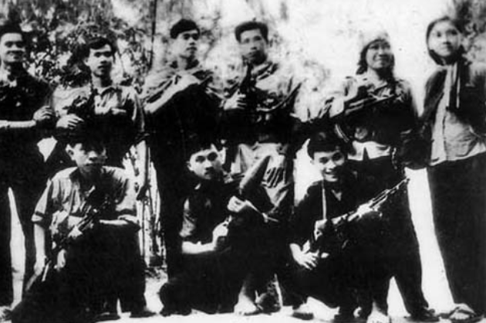
Attack on US embassy (note “Long Hairs!)
….kill guards, enter compound, all killed
….attack televised on US nightly news

Slide 5
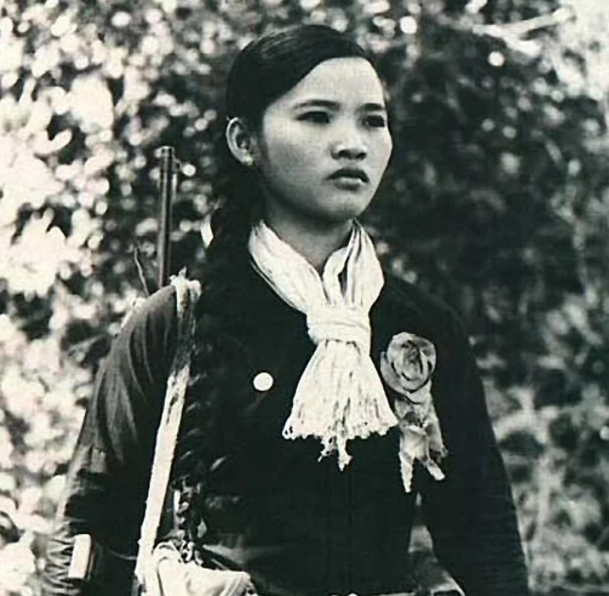

Slide 6
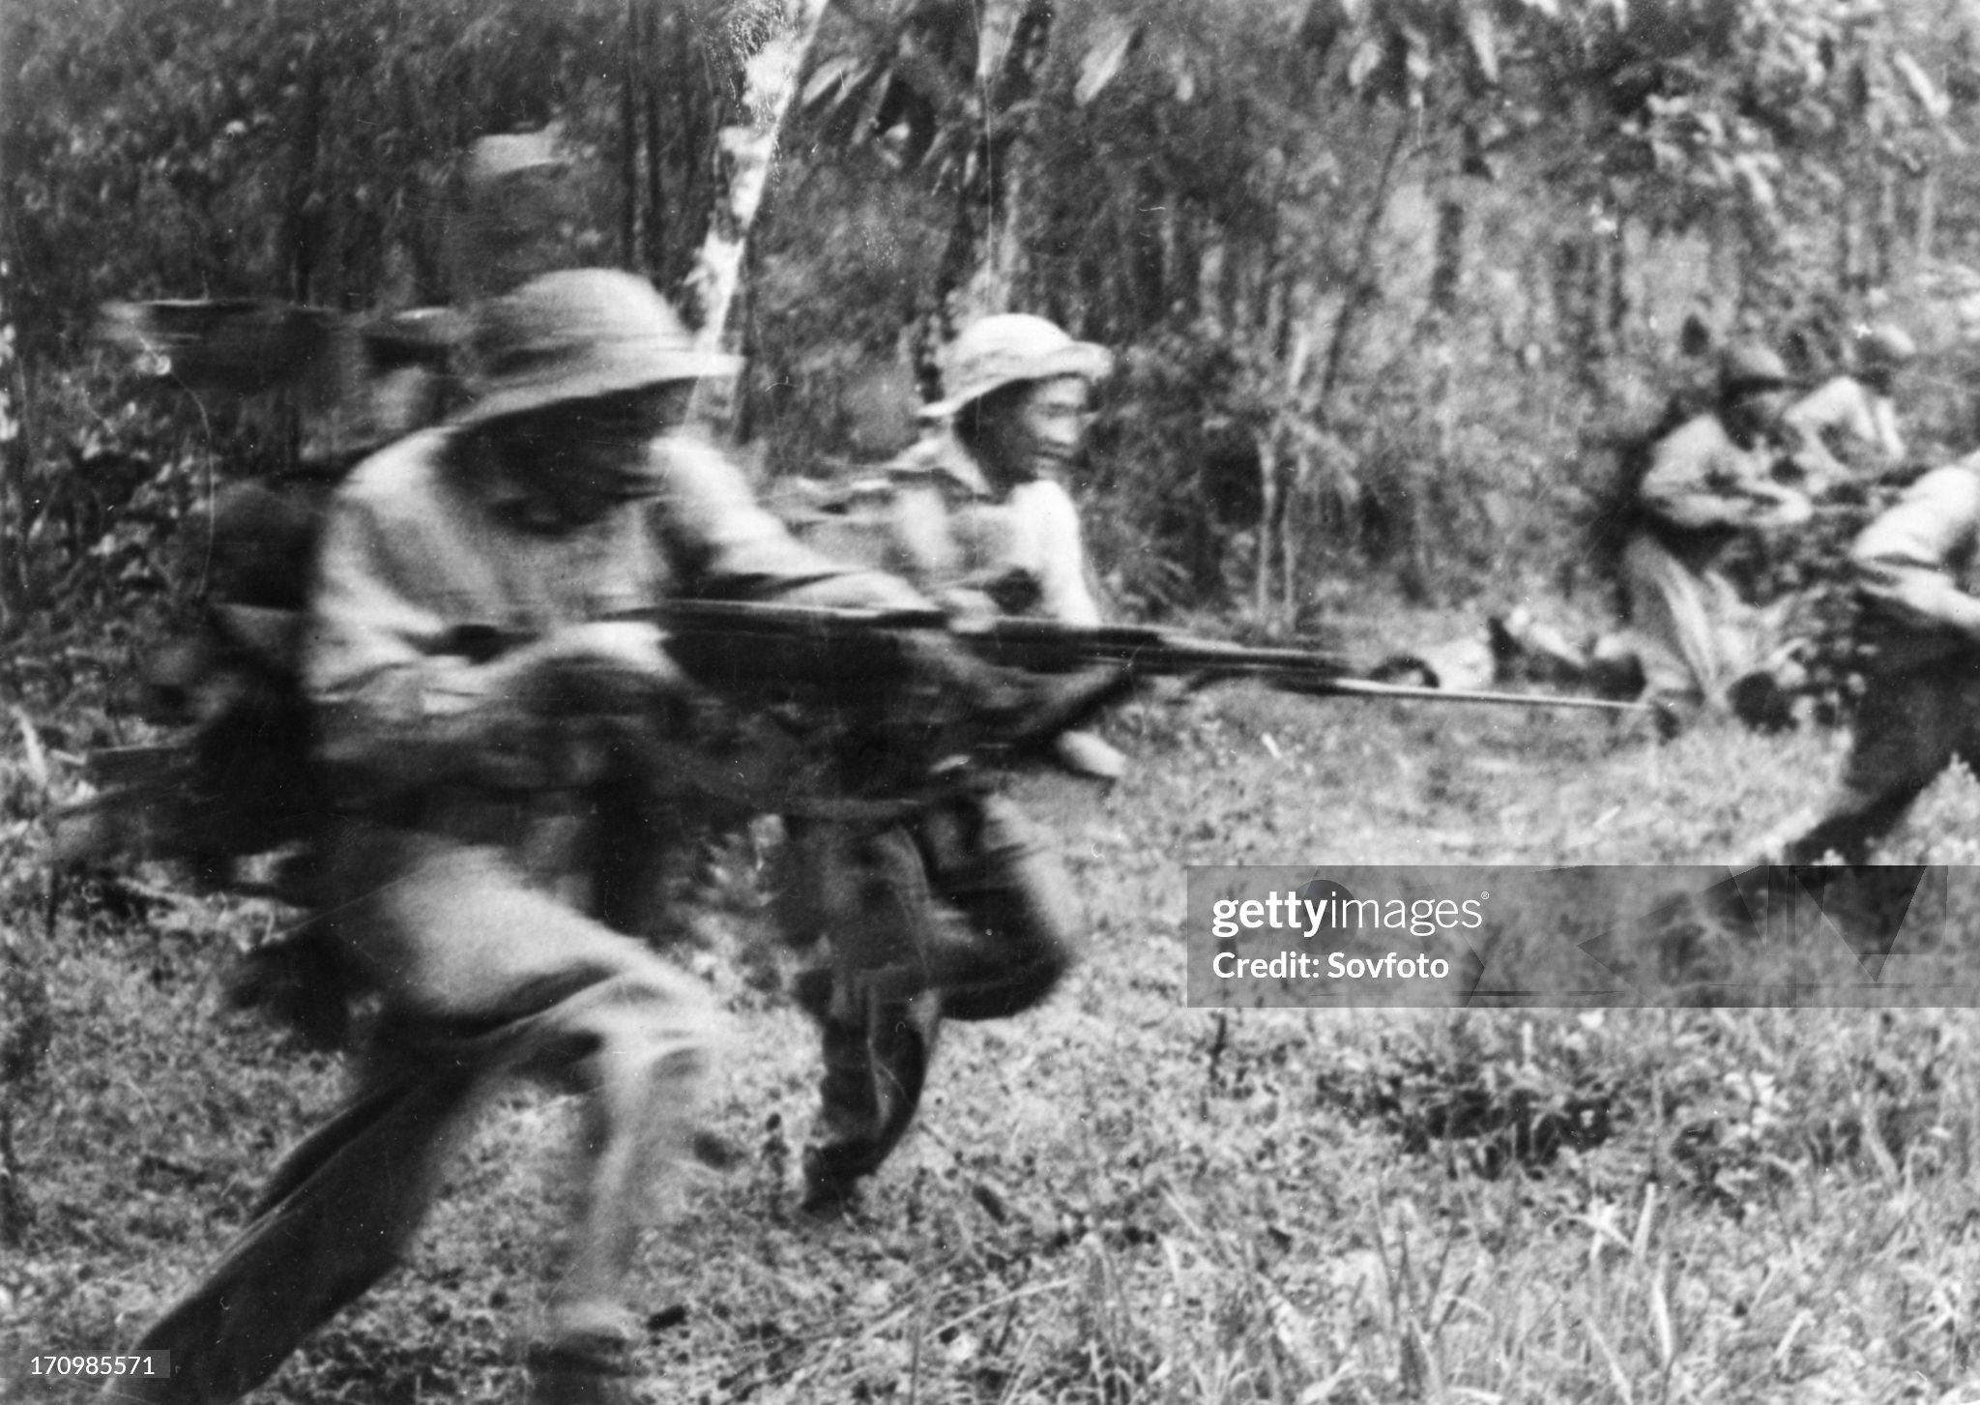
Viet Cong “human wave” attack

Slide 7
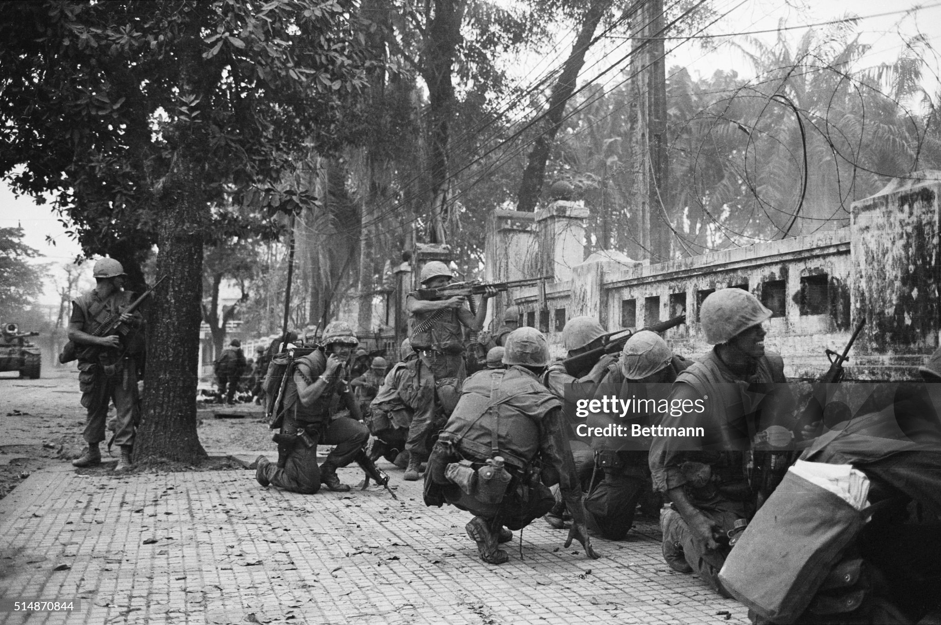
Recapture Hue…street fighting/ full scale war

Slide 8
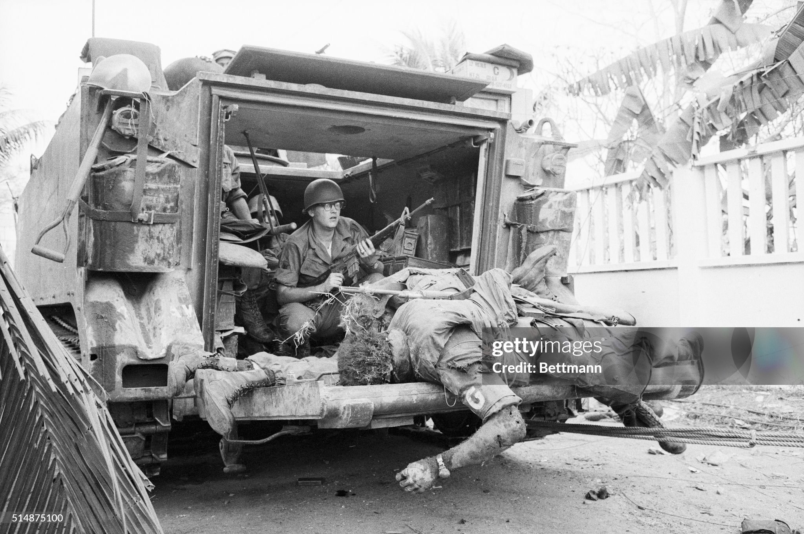
Intense street fighting…high casualties

Slide 9
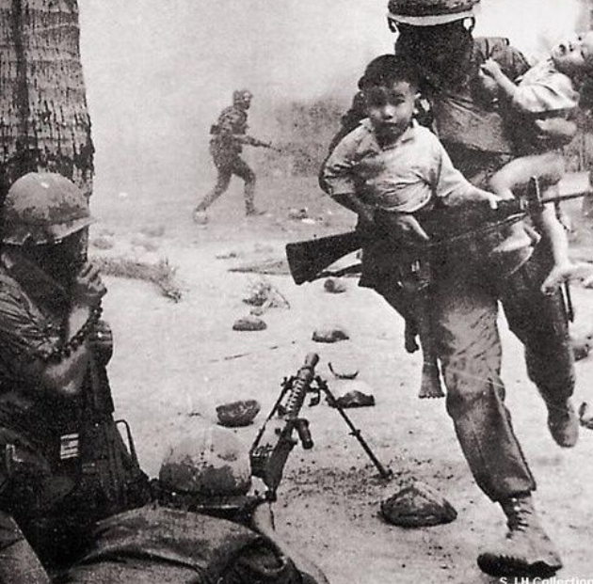

Slide 10
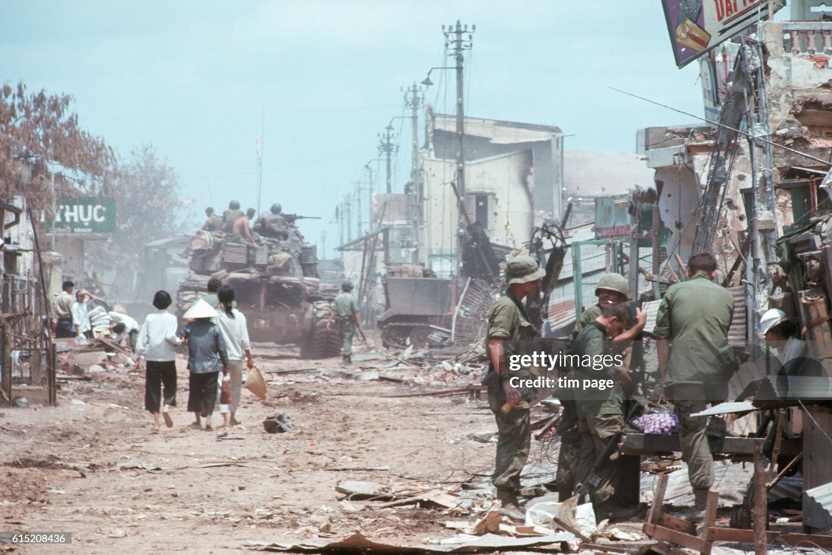
Saigon after Tet

Slide 11
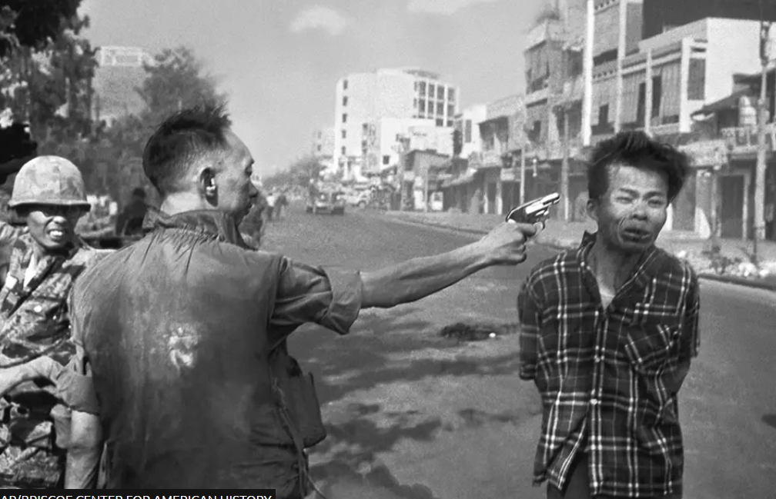
The picture that lost the war.
……….execution of Vietcong..depicted as symbol of corruption
…after discovery he had killed wife and children of general Loan colleague
Epilogue: Duan flees to US….pursued by media rest of life…sets up restaurant to support family
..driven to bankruptcy“The general killed the VietCong with his gun, I killed the General with my camera ….…Eddie Evans (1985)

Slide 12
Tet Offensive Military Impact
No national rising…South Vietnamese army fights
Offensive fails….US / South Vietnamese counterattack
  100,000 North Vietnamese/ Vietcong casualties (50,000 deaths)
  Vietcong destroyed as military force: 50% plus of available fighters
  North Vietnamese consider TET major defeat…return to guerrilla war
US military claim victory: 12,000 US killed and wounded, 25,000 Vietnamese army
Widespread devastation/ horror
  16,000 civilians killed
  Mass execution of 3,500 Hue Civil Servants by VC 3,500
US Army…….”not winning war”…..increased brutalization

Slide 13
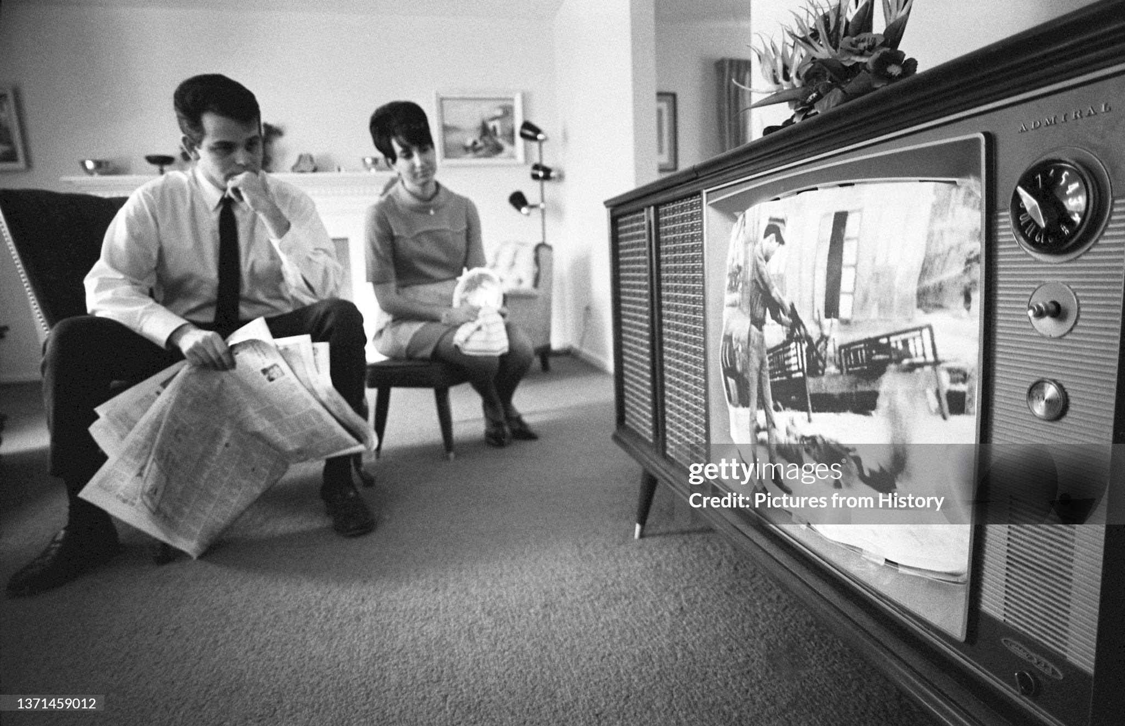
TET and the news…..every night
…and we were told that we were winning

Slide 14
Political Impact
US public lose belief in government
  Public support collapses from 50% to less than 30%...promise of victory ..lies
  Anti War demonstrations increase across country
  Media portray war as “unwinnable”…compounded by Race Riots across USA
LBJ Strategy Change
  Removes/ “promotes” McNamara (to World Bank) Westmoreland (Chief of Staff)
  Invites North Vietnamese, Vietcong to Peace Conference Paris
  Announces decision to withdraw from 1964 Presidential election
Vietnam becomes focus of US Presidential election
….and future of Vietnam War dependent on result

Slide 15
Elections and Negotiations
US elections “all about the war” (for review next talk)
  Democrats split Anti War vs Wind down War factions…violent 1968 Convention
    Choose LBJ preferred Hubert Humphrey (after Bobby Kennedy assassination)
  Republican choose Richard Nixon “Secret Plan to End the War”
Paris negotiations
  Start May 1968…table shape negotiation till October
  “The problem of the South…North rejects each other’s presence
  Break through …all agree to start talks
Nixon sabotages Peace Talks
  Humphrey support increases 10% as Peace talks start
  Nixon intervention…advises Thieu not attend, wait for him to win
  Talks collapse….Nixon support recovers….

Slide 16
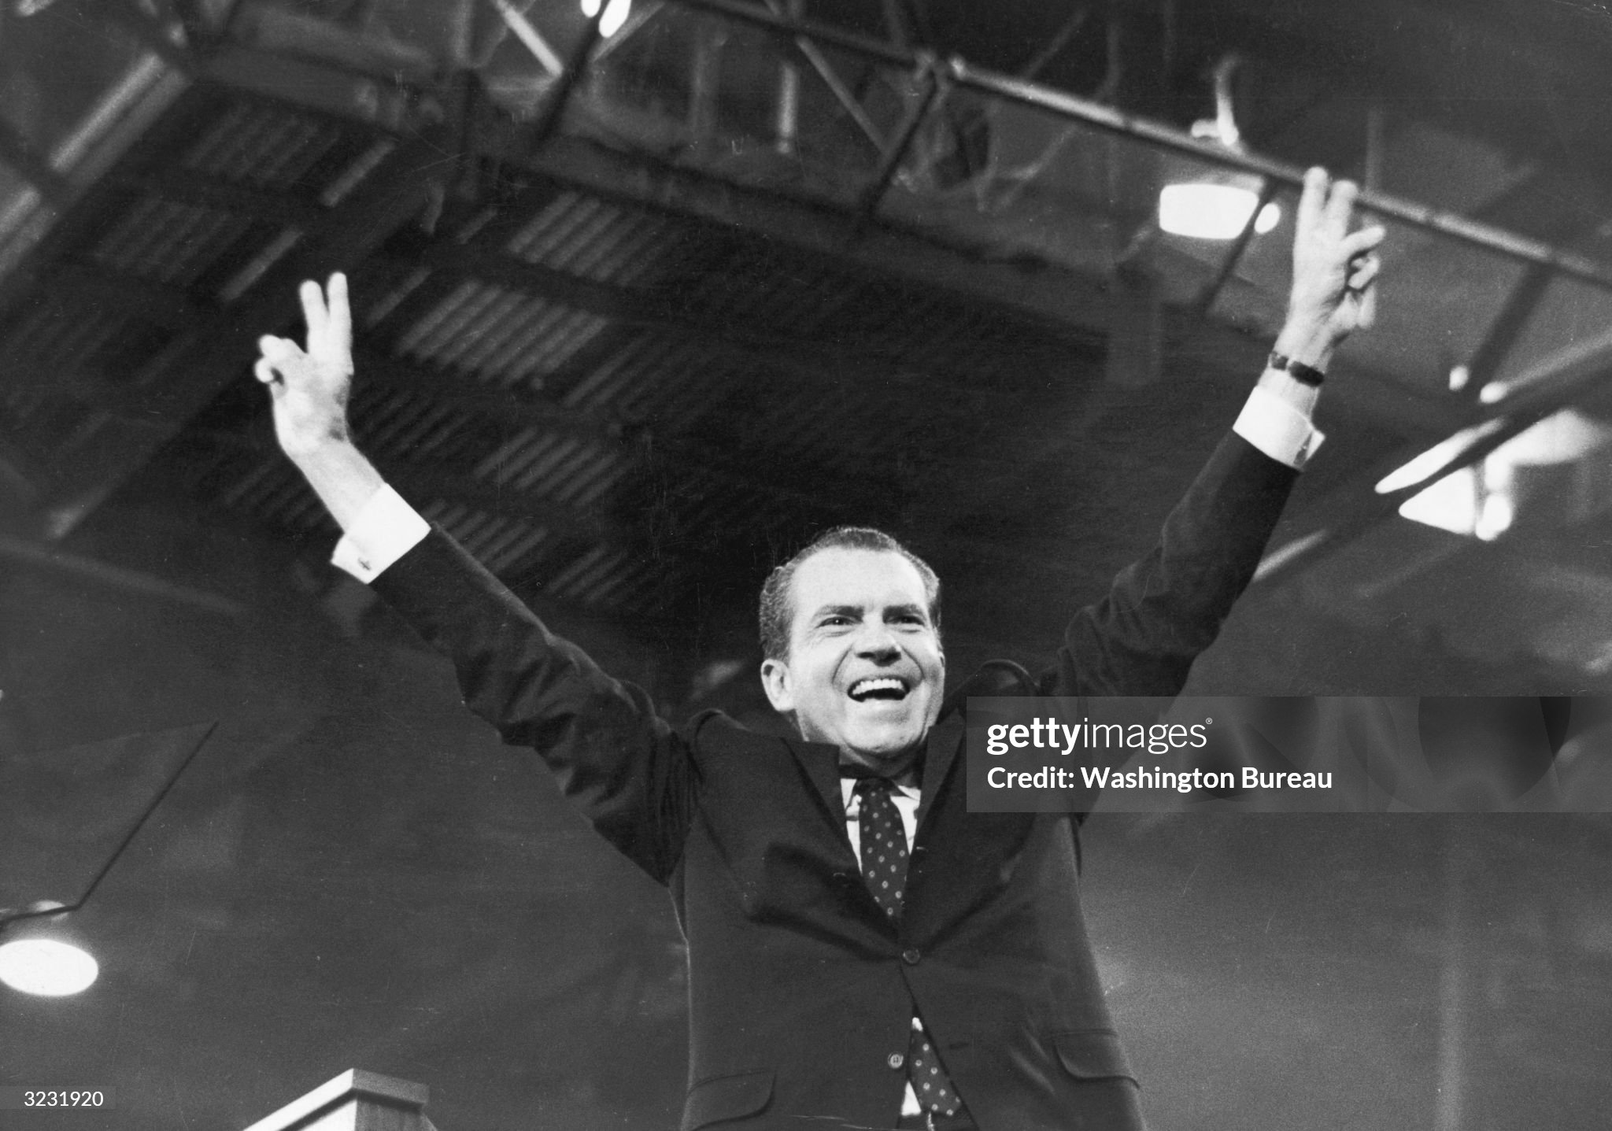
Nixon wins narrow election
…”secret plan to be revealed”

